Slide 1
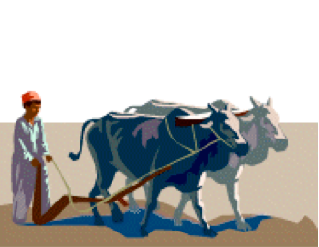
Luke 9:62

Slide 2
Who is Fit For It?
Fit:
Euthetos – “ready for use, fit, well adapted, lit. Well placed …” (W.E. Vine)
To be FIT is to be USEFUL

Slide 3
The Worldly-Minded Christian
Hypocritical Example Damages Image of Christ
Causes Problems in Church –
1 Corinthians 3:1-3
Will Eventually Fall Away –
2 Timothy 4:10

Slide 4
The Worldly-Minded Christian
The Lord Wants Disciples to be “Salt of the Earth” –
Matthew 5:13; Luke 14:34-35
The Christian who loses his “fitness” is good for nothing

Slide 5
Qualities of One Who is Fit For The Master’s Use
Realizes he is no longer his own –
1 Corinthians 6:19-20
Can no longer do as he pleases, but as the Lord wills –
Matthew 16:24; 7:21
Service to God never stops –
Revelation 2:10

Slide 6
Qualities of One Who is Fit For The Master’s Use
Attitude Same as Paul – “Press On”
Philippians 3:12-15
He is Committed to The Lord –
Mark 10:17-22
Will be Faithful no Matter What –
2 Timothy 4:16

Slide 7
Qualities of One Who is Fit For The Master’s Use
He Does Good Works –
Titus 2:14; Ephesians 2:10
He Teaches Others, in Word and By Example, How to Become a Christian
He Encourages Other Christians –
Hebrews 10:24-25

Slide 8
Qualities of One Who is Fit For The Master’s Use
He Corrects the Erring –
James 5:6; Galatians 6:1-2
He Looks to the Material Needs of Others –
Ephesians 4:28
He Lives a Godly Life –
1 Timothy 6:6; Romans 12:1-2

Slide 9
He Takes Seriously What God Says
Marriage – Ephesians 5:25-28
Children – Ephesians 6:1-4
Work – Colossians 3:22-24
Government – Romans 13:6-7
Material and Financial Matters – Romans 13:8
The World – 1 John 2:15-17; 1 Peter 2:11-12

Slide 10
He Seeks to Mature in Christ
Producing Fruit of the Spirit – Galatians 5:22
Adding Attributes to Faith – 2 Peter 1:5-9
Studying the Word – 2 Timothy 2:15
Exercising Spirituality – Hebrews 5:14
The Mature Christian is the one who is Most Useful

Slide 11
Tragic When One Allows Himself to Become Useless to The Lord, Thus Worthless and Unprofitable in His Sight
John 15:1-8

Slide 12
Want a Quick Measure of Your Usefulness to Him?
What would this church lose if it lost you?
Of what value are you to this church?
Can this church count on you?
If not, how could the Lord count on you?

